Slide 1
OBJECT ORIENTED PROGRAMMING
Lecture 12

Slide 2
Collections in Java
Collections are objects that allow you to store and manipulate groups of elements. Collections are an important part of the Java language and provide a wide variety of data structures and algorithms to work with.
Java's collection framework provides interfaces and classes for different types of collections such as List, Set, Map, Queue, and others. These collections differ in their behavior, like whether they allow duplicates or not, the order in which elements are stored, etc.

Slide 3
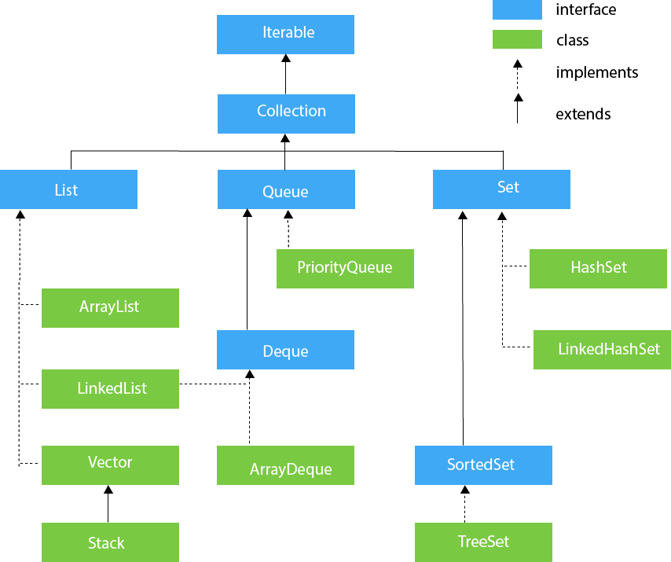
Collections in Java

Slide 4
Most commonly used collections in Java:
ARRAYLIST: A resizable array implementation of the List interface. It allows you to add or remove elements dynamically and provides fast access to elements by index.
LINKEDLIST: A doubly linked list implementation of the List interface. It is optimized for adding or removing elements from the middle of the list and provides better performance for certain operations than ArrayList.

Slide 5
Most commonly used collections in Java:
HASHSET: A set implementation that does not allow duplicates. It uses a hash table to store elements and provides constant-time performance for add, remove, and contains operations.
TREESET: A set implementation that stores elements in sorted order. It provides guaranteed log(n) time cost for the basic operations (add, remove, and contains).

Slide 6
Most commonly used collections in Java:
QUEUE: Queue interface represents a collection that holds elements in a specific order for processing. It follows the First-In-First-Out (FIFO) principle, where elements are added to the end of the queue and removed from the beginning. The Queue interface extends the Collection interface and adds additional methods specific to queues.

Slide 7
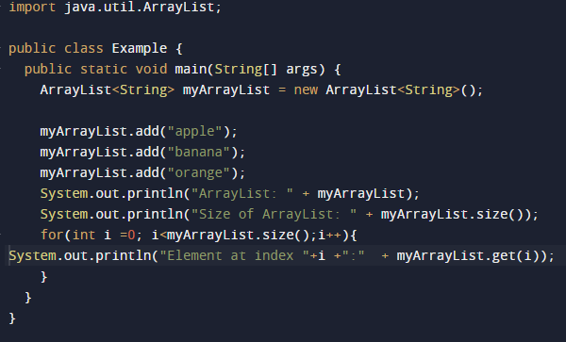
ArrayList in Java

Slide 8
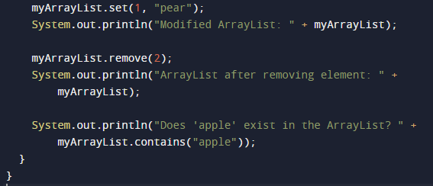
ArrayList in Java

Slide 9
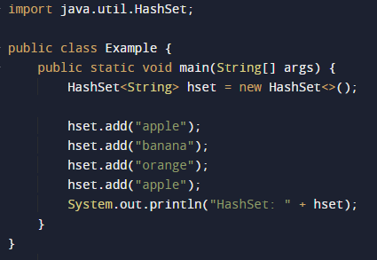
HashSet in Java

Slide 10
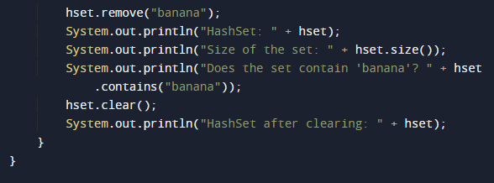
HashSet in Java

